Slide 1


Using a Shiny App in Public Health research
Jaime Villacampa and Andrew Baxter

Slide 2


What is Shiny?
A package that makes interactive websites.
Translates R code into web code: HTML, CSS and JavaScript.

Slide 3
Why use Shiny?
Free to develop and deploy (with paid options)
Flexibility and Potential
Teamwork
Public engagement
Reproducibility and open research
But…
Another new thing?!
Easy for public-facing data, not as easy for confidential information
Time for development

Slide 4
Differences from normal R code
Three parts: global, ui and server
Reactive to user input
Ability to integrate CSS/HTML/Javascript
Structure and running order of code

Slide 5
The key building blocks
The User Interface
ui.R
`*Input(inputId = "a")` - passes input "a" to server
… layout/structure of ui …
`*Output(outputId = "b")` - gets output "b" from server
The server
server.R
`input$a` - gets input "a" from ui
… R code processes …
`output$b <- render*(...)` - passes output "b" to ui

Slide 6
Structuring the User Interface
ui.R
fluidPage(
titlePanel(...),
sidebarLayout(
sidebarPanel(
...
),
mainPanel(
...
...
...
...
)
)
)
Title
fluidPage(
titlePanel(...),
sidebarLayout(
sidebarPanel(
...
),
mainPanel(
...
...
...
...
)
)
)
Inputs…
Outputs…

Slide 7
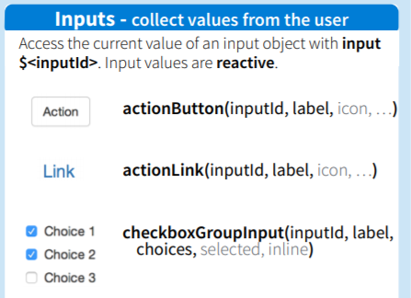
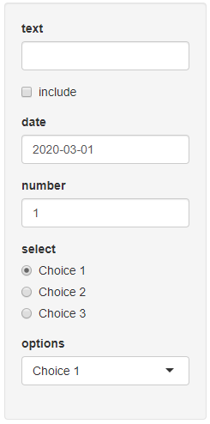
Input functions - examples
Input in ui.R
input$id in server.R
textInput()
checkboxInput()
numericInput()
radioButtons()
selectInput()
String
Logical
Numeric
String – chosen option
https://shiny.rstudio.com/images/shiny-cheatsheet.pdf
R()

Slide 8
Output functions - examples
Rendered in server.R
Outputted in ui.R
output$x <- renderText()
output$y <- renderPlot()
output$z <- renderDataTable()
textOutput(outputId = 'x')
plotOutput(outputId = 'y')
dataTableOutput(outputId = 'z')

Slide 9
Output functions - examples
Rendered in server.R
Outputted in ui.R
output$x <- renderText()
output$y <- renderPlot()
output$z <- renderDataTable()
textOutput(outputId = 'x')
plotOutput(outputId = 'y')
dataTableOutput(outputId = 'z')
R()

Slide 10
Passing and processing
ui.R
server.R
ui.R
intypeInput(
InputId = "a", ...
),
output$x <- renderOuttype(
func(input$a, ...)
)
outtypeOutput(
outputId = "x"
),
Reactive

Slide 11
Multiple inputs
ui.R
server.R
ui.R
intypeInput(
InputId = "a", ...
),
output$x <- renderOuttype(
func(input$a, input$b, ...)
)
outtypeOutput(
outputId = "x"
),
intypeInput(
InputId = "b", ...
),
R()

Slide 12
ui.R
server.R
ui.R
outtype1Output(
outputId = "x"
),
intypeInput(
InputId = "a", ...
),
???
outtype2Output(
outputId = "y"
),

Slide 13
The reactive() element
ui.R
server.R
ui.R
output$x <- renderOuttype1(
func(df(), ...)
)
outtype1Output(
outputId = "x"
),
df <- reactive(
func(input$a)
)
intypeInput(
InputId = "a", ...
),
output$y <- renderOuttype2(
func(df(), ...)
)
outtype2Output(
outputId = "y"
),
R()

Slide 14
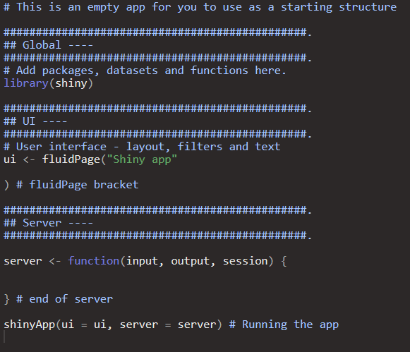
How this translates into “action”?
R()

Slide 15
How to publish an app
shinyapps.io cloud server: https://www.shinyapps.io/
Shiny Server: https://rstudio.com/products/shiny/shiny-server/
Shiny Proxy: https://www.shinyproxy.io/
Server-less option

Slide 16
There is more than code to Shiny
Version control
User testing, over and over
Different skill set: design, visual, creative

Slide 17
Add-ons/customization
Lots of options to customise your app, some easier than others:
Packages: shinyWidgets, shinythemes and shinycssloaders-
Packages: shinyjs, shinyBS
Create your own HTML, CSS or JavaScript

Slide 18
Exercises
The dataset we are going to use is based on Census data.
It includes standardizes rates on self-rated health for different ethnicities split by age group and SIMD deprivation quintile.
The standardizes rates refer to two measures of self-rated health: poor general health and limiting long-term illness.
Everything calculated, try to do most of your calculations outside Shiny to speed up your app.
https://github.com/ScotPHO/r-pubhealth-workshop/wiki
R()

Slide 19
Gallery of apps
There are many examples of Shiny apps presenting public health data.A good place to start looking for examples is the official gallery: https://shiny.rstudio.com/gallery/
Socioeconomic inequalities in health in Scotland: https://mirjamallik.shinyapps.io/SIH_ethnicity/
ScotPHO profiles tool: https://scotland.shinyapps.io/ScotPHO_profiles_tool/ https://github.com/ScotPHO/scotpho-profiles-tool
Scottish burden of disease: https://scotland.shinyapps.io/scotpho-burden-disease/
COVID-19 wider impacts on health: https://scotland.shinyapps.io/phs-covid-wider-impact/ https://github.com/Health-SocialCare-Scotland/covid-wider-impact
Shiny contest apps for even more ideas: https://community.rstudio.com/c/shiny/shiny-contest/30

Slide 20
Useful resources
We have created a list of useful resources to help with Shiny here: https://github.com/ScotPHO/r-pubhealth-workshop/wiki/Useful-resources

